Slide 1


Vincent Ku
24-07-2024

Slide 2

Outline
Executive Summary
Introduction
Methodology
Results
Conclusion
Appendix

Slide 3
Executive Summary
Methodologies
REST API + BeautifulSoup
EDA
Visualizations
Machine learning models to predict mission outcome
Summary of all results
Models are able to predict the success mission outcomes but unable to predict the failed mission outcomes accurately
There might be other factors that caused failure in landing and need to be considered to rebuild the model

Slide 4
Introduction
Investigating the commercial space age
Investigating perspectives: How does SpaceX stand out among competitors?
Does SpaceX reuse the first stage?
Predicting the landing outcomes of SpaceX’s Falcon 9

Slide 5

Section 1

Slide 6
Methodology
Executive Summary
Data collection methodology:
Data was collected from SpaceX REST API endpoints
Web scraping from Wikipedia was performed
Perform data wrangling
Data was processed using Pandas
Perform exploratory data analysis (EDA) using visualization and SQL
Perform interactive visual analytics using Folium and Plotly Dash
Perform predictive analysis using classification models
Built 4 different models and tune them using cross validation

Slide 7
Data Collection
Data was collected by sending requests to SpaceX REST API endpoints & web scrap from Wikipedia
Workflow:
API requests
Web scraping
Store the result in Pandas Data frame
Data handling

Slide 8
Data Collection – SpaceX API
Data collection with SpaceX REST API calls
Work (Jupyter)
API GET requests
Data handling with Pandas

Slide 9
Data Collection - Scraping
Web scraping from Wikipedia
Work (Jupyter)
Request Falcon9 Launch page from Wiki URL
Web scraping using BeautifulSoup
Data handling with Pandas

Slide 10
Data Wrangling
EDA were performed with Pandas to find patterns in the data and determine what would be the label for training supervised models
Workflow:
Work (Jupyter)
Analyzing the no. of launches
Analyzing different orbit
Analyzing the different mission outcomes
Creating a landing outcome label

Slide 11
EDA with Data Visualization
Created different visualizations using Seaborn and Matplotlib to investigate data trends
Scatter plot: To explore the relationships between variables
Bar chart: To explore the success rate of different Orbits
Line chart: To explore the success rate as year pass
Work (Jupyter)

Slide 12
EDA with SQL
Performed SQL queries to extract desired data stored in database
Selecting the payload mass, date of landing, mission outcome, etc.
Analyzing the relationship between booster version, payload and launch sites
Work (Jupyter)

Slide 13
Build an Interactive Map with Folium
Created a Folium map with different map objects
Circle: Locate the launch sites
Marker: Mark the success/failed launches for each site
Polyline: Calculate the distances between a launch site to its proximities
Work (Jupyter)

Slide 14
Build a Dashboard with Plotly Dash
Included visualizations to show correlations
Pie chart (with site list): To show the number of success launches by site
Scatter plot (with payload range slider): To show the correlation between payload and success launches by site
Work (Python script)

Slide 15
Predictive Analysis (Classification)
Built 4 different ML models (Log Reg, SVM, Tree, KNN) and use GridSearchCV to find the best model with the highest accuracy
Workflow
Work (Jupyter)
Standardization & create train/test data
Fit the model with train data
Use cross-validation to find the best model
Test the accuracy on test data

Slide 16
Results
Exploratory data analysis results
Interactive analytics demo in screenshots
Predictive analysis results

Slide 17

Section 2

Slide 18
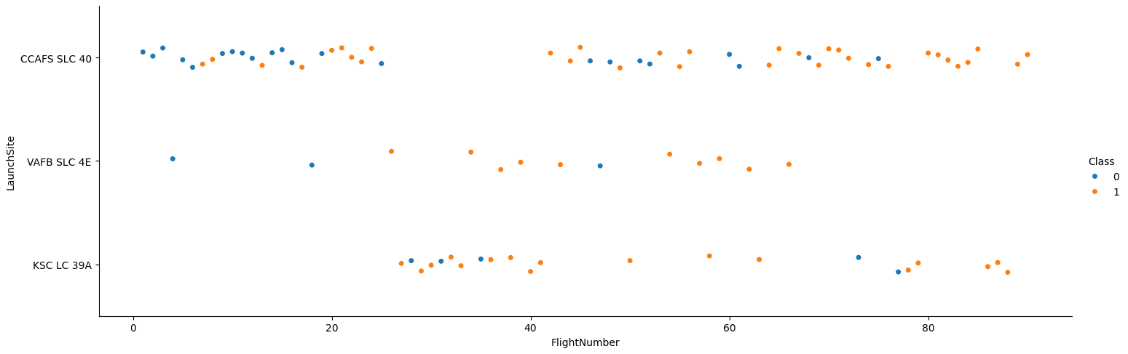
Flight Number vs. Launch Site
Scatter plot of Flight Number vs. Launch Site

Slide 19
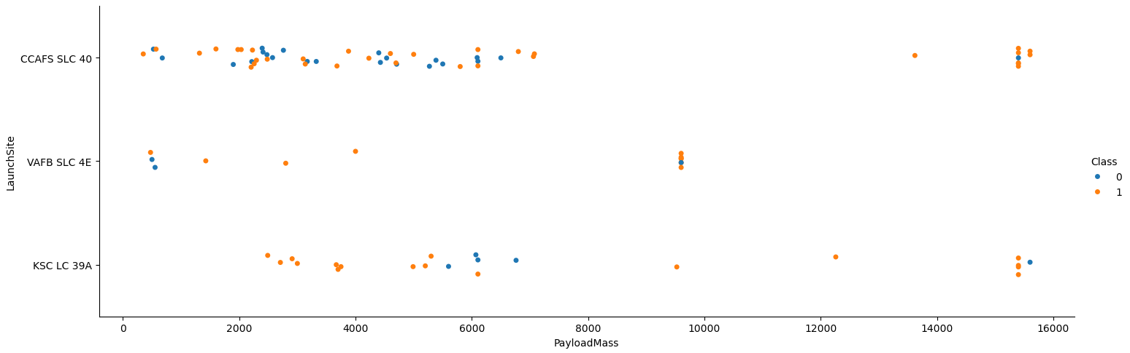
Payload vs. Launch Site
Scatter plot of Payload vs. Launch Site

Slide 20
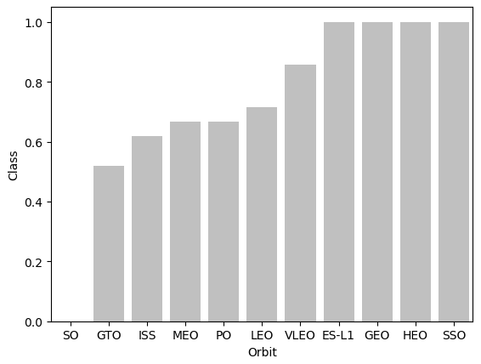
Success Rate vs. Orbit Type
Bar chart for the success rate of each orbit type

Slide 21
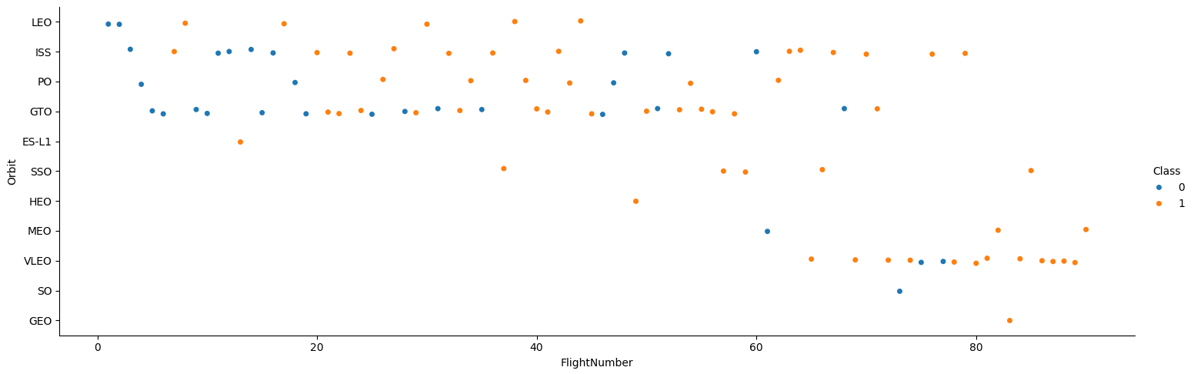
Flight Number vs. Orbit Type
Scatter point of Flight number vs. Orbit type

Slide 22
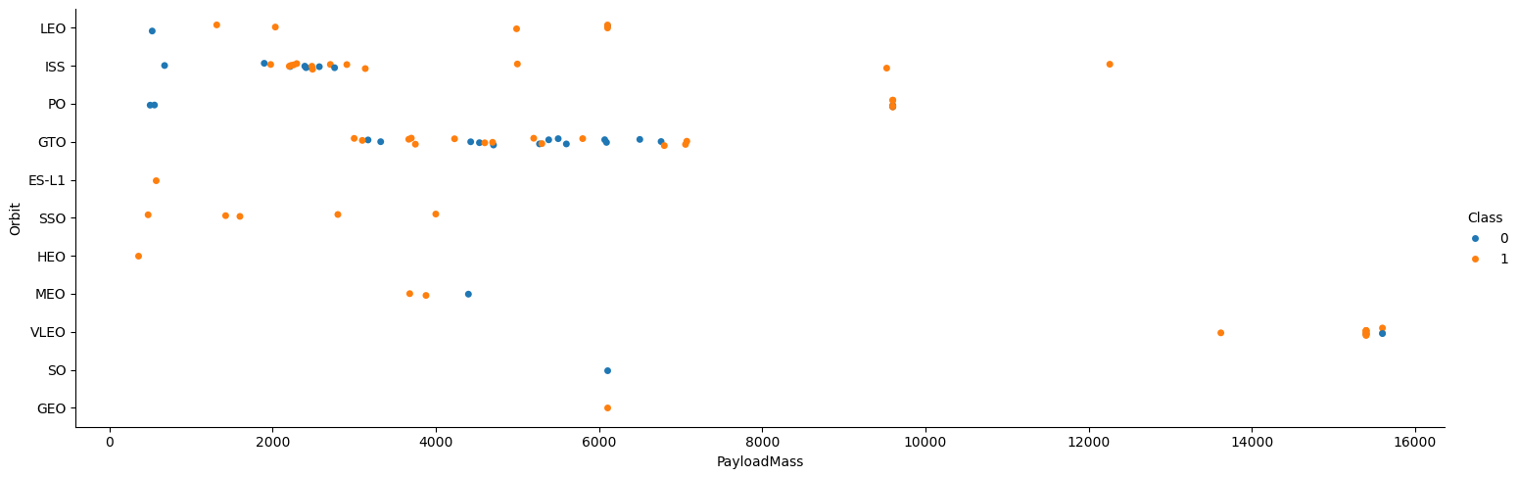
Payload vs. Orbit Type
Scatter point of payload vs. orbit type

Slide 23
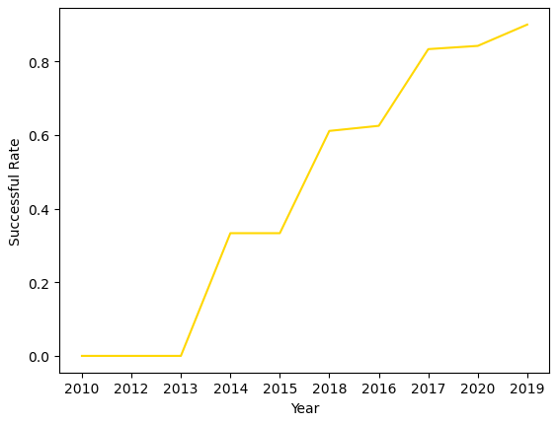
Launch Success Yearly Trend
Line chart of yearly average success rate

Slide 24
All Launch Site Names
Used SQL to find the names of the unique launch sites in the space mission
CCAFS LC-40
VAFB SLC-4E
KSC LC-39A
CCAFS SLC-40

Slide 25
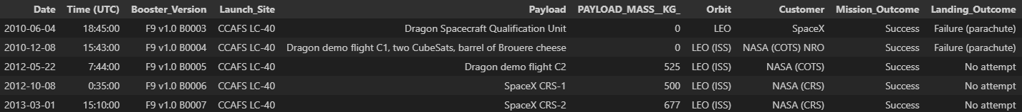
Launch Site Names Begin with 'CCA'
Used SQL to find 5 records where launch sites begin with `CCA`

Slide 26
Total Payload Mass
Used SQL to find the total payload carried by boosters from NASA
45596 (kg)

Slide 27
Average Payload Mass by F9 v1.1
Used SQL to find the average payload mass carried by booster version F9 v1.1
2928.4 (kg)

Slide 28
First Successful Ground Landing Date
Used SQL to find the dates of the first successful landing outcome on ground pad
2015-12-22

Slide 29
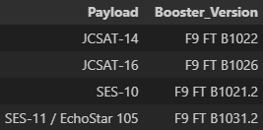
Successful Drone Ship Landing with Payload between 4000 and 6000
Used SQL to find the names of boosters which have successfully landed on drone ship and had payload mass greater than 4000 but less than 6000

Slide 30
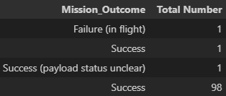
Total Number of Successful and Failure Mission Outcomes
Used SQL to find the total number of successful and failure mission outcome

Slide 31
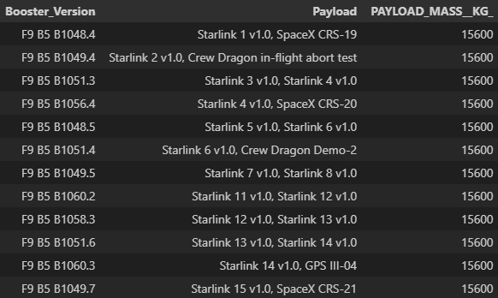
Boosters Carried Maximum Payload
Used SQL to find the names of the booster which have carried the maximum payload mass

Slide 32
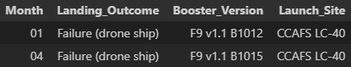
2015 Launch Records
Used SQL to find the failed landing_outcomes in drone ship, their booster versions, and launch site names for in year 2015

Slide 33
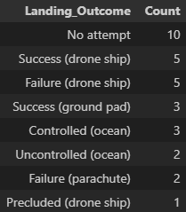
Rank Landing Outcomes Between 2010-06-04 and 2017-03-20
Used SQL to find the count of landing outcomes (such as Failure (drone ship) or Success (ground pad)) between the date 2010-06-04 and 2017-03-20, in descending order

Slide 34

Section 3

Slide 35
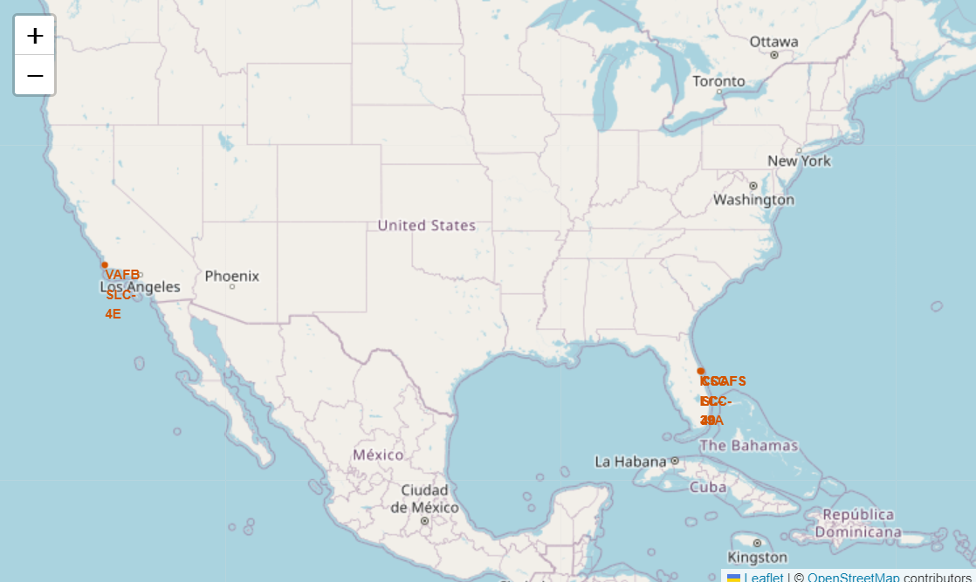
Folium Map – All Launch Sites
All launch sites has been marked on the map

Slide 36
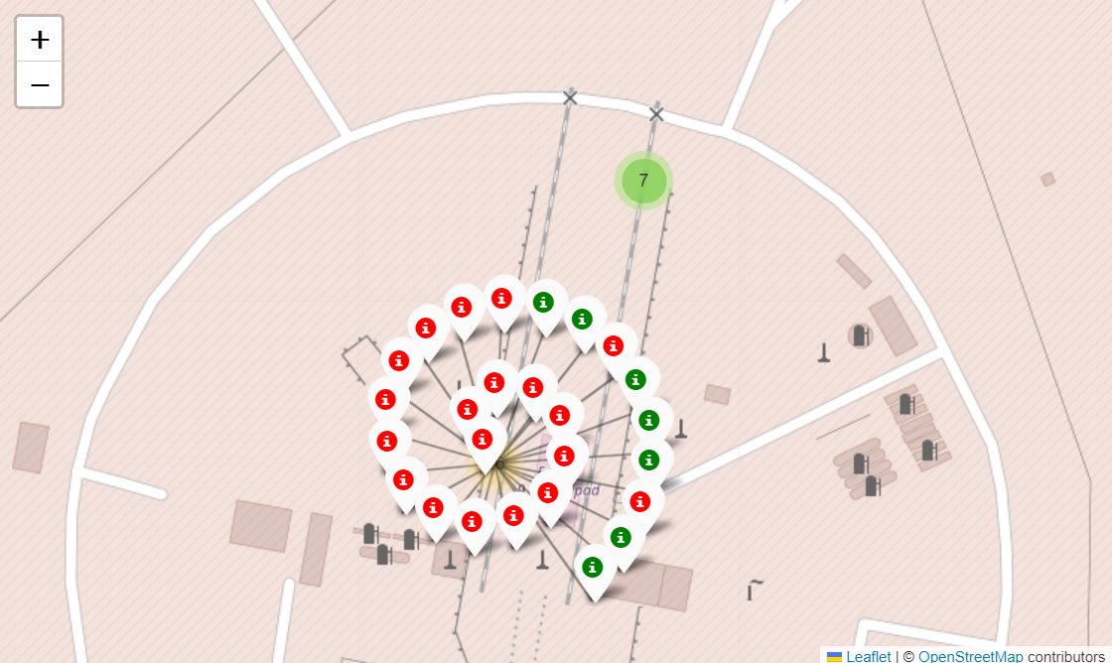
Folium Map – Success/Failed launches
All success/failed launches for each site has been marked on the map

Slide 37
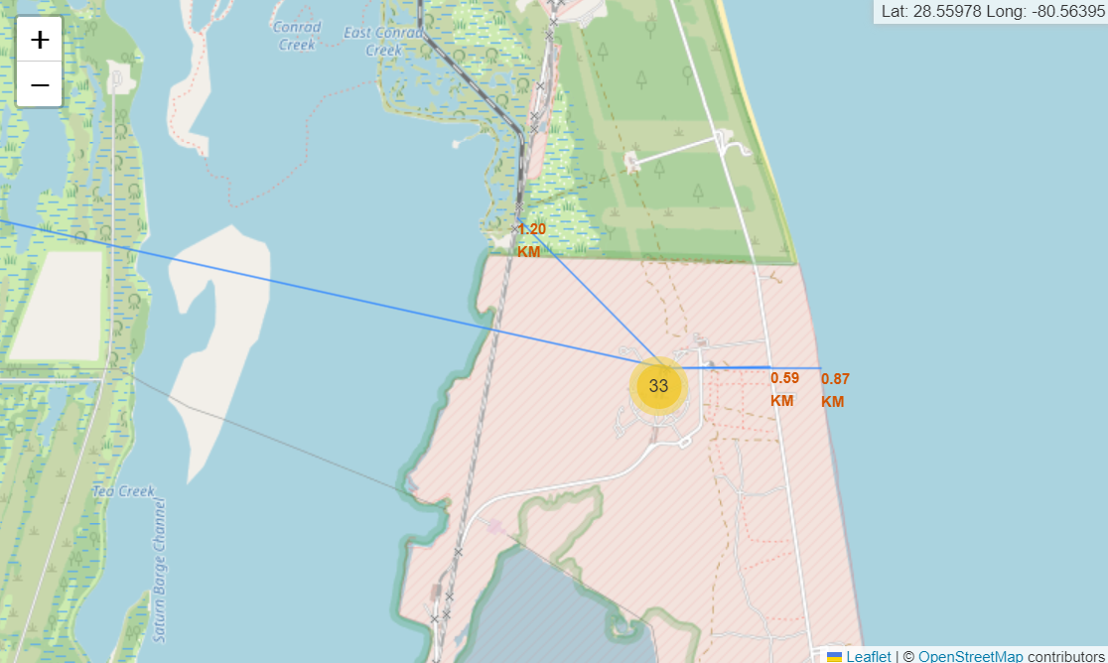
Folium Map – Distance to its proximities
The distances between a launch site to its proximities (coastline, rail, city, highway) have been calculated and marked on the map

Slide 38

Section 4

Slide 39
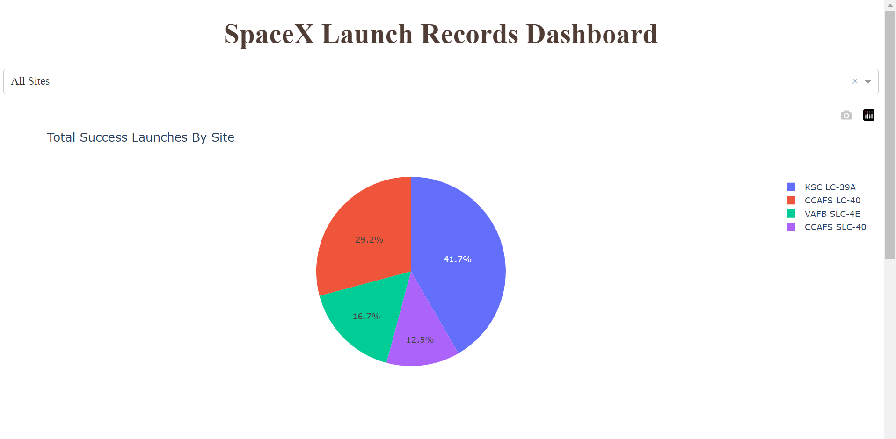
Dashboard – Pie Chart of Success Launches
Pie chart of success launches of all sites
KSC LC-39A has the most success launches

Slide 40
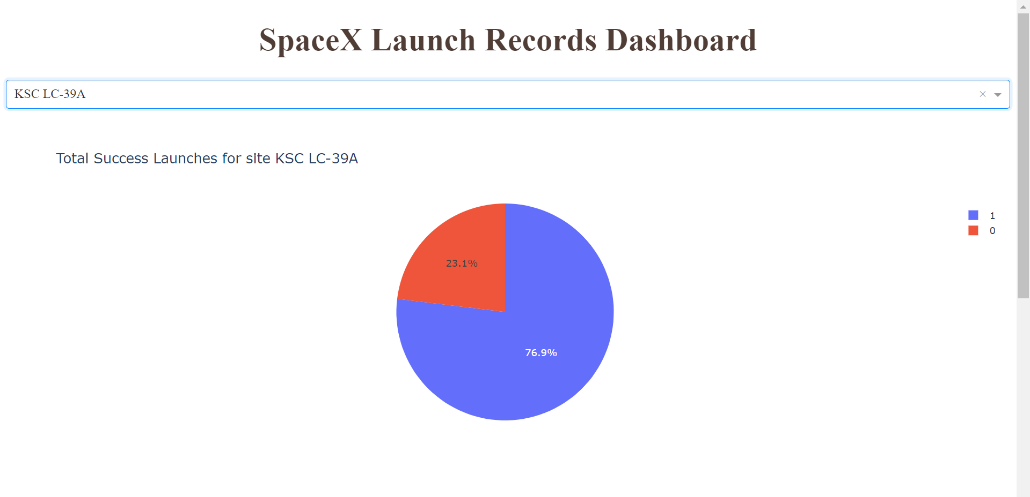
Dashboard – Pie Chart of Highest Success Ratio
Pie chart of total success launches for site KSC LC-39A
It has the highest launch success ratio with 76.9%

Slide 41
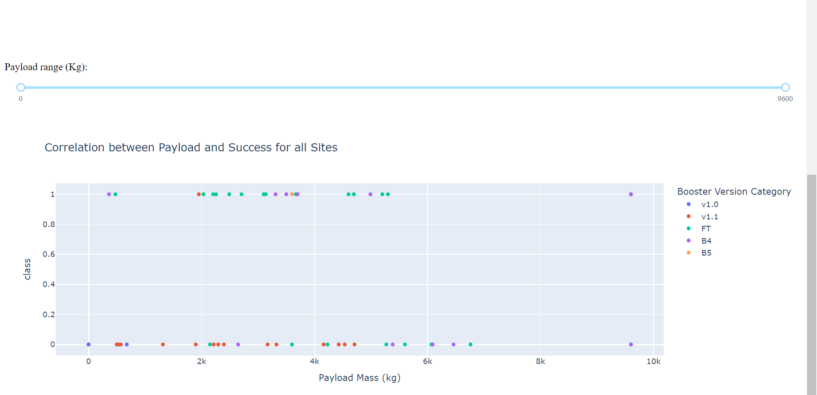
Dashboard – Scatter Chart of Payload vs Outcome
Scatter chart of correlation between payload and success launch for all sites
Booster version FT has the most success launches
Booster version B4 has success launches for heaviest payloads

Slide 42

Section 5

Slide 43
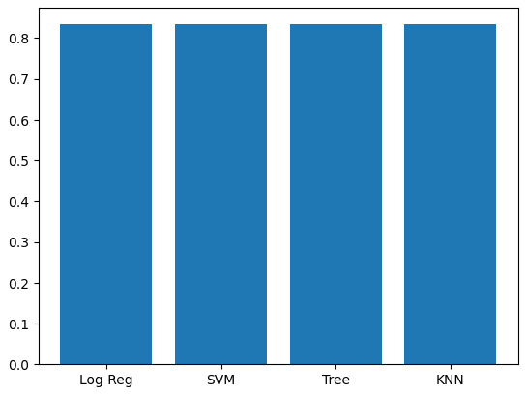
Classification Accuracy
X-axis: Model Y-axis: Accuracy
All 4 models have the same accuracy on training data

Slide 44
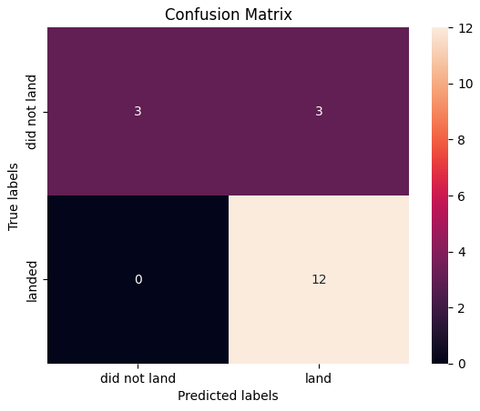
Confusion Matrix
All models have the true positive and true negative rate
True positive: 1.0
True negative: 0.5

Slide 45
Conclusions
The models built based on this dataset can predict whether the first stage can land accurately, but cannot effectively predict when the first stage failed to land
There might be other factors that caused failure in landing, and we did not consider
The success of the mission outcome is relatively related to the launch site / orbit

Slide 46
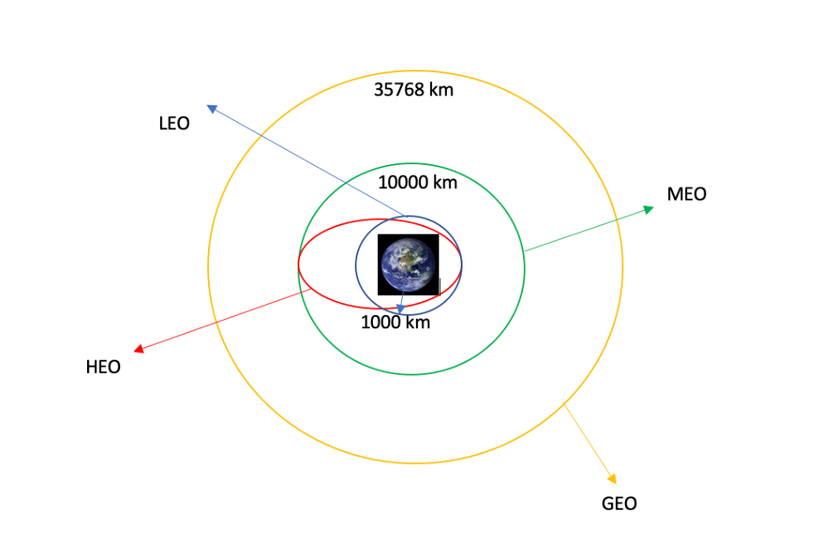
Appendix
Orbit

Slide 47


